Slide 1
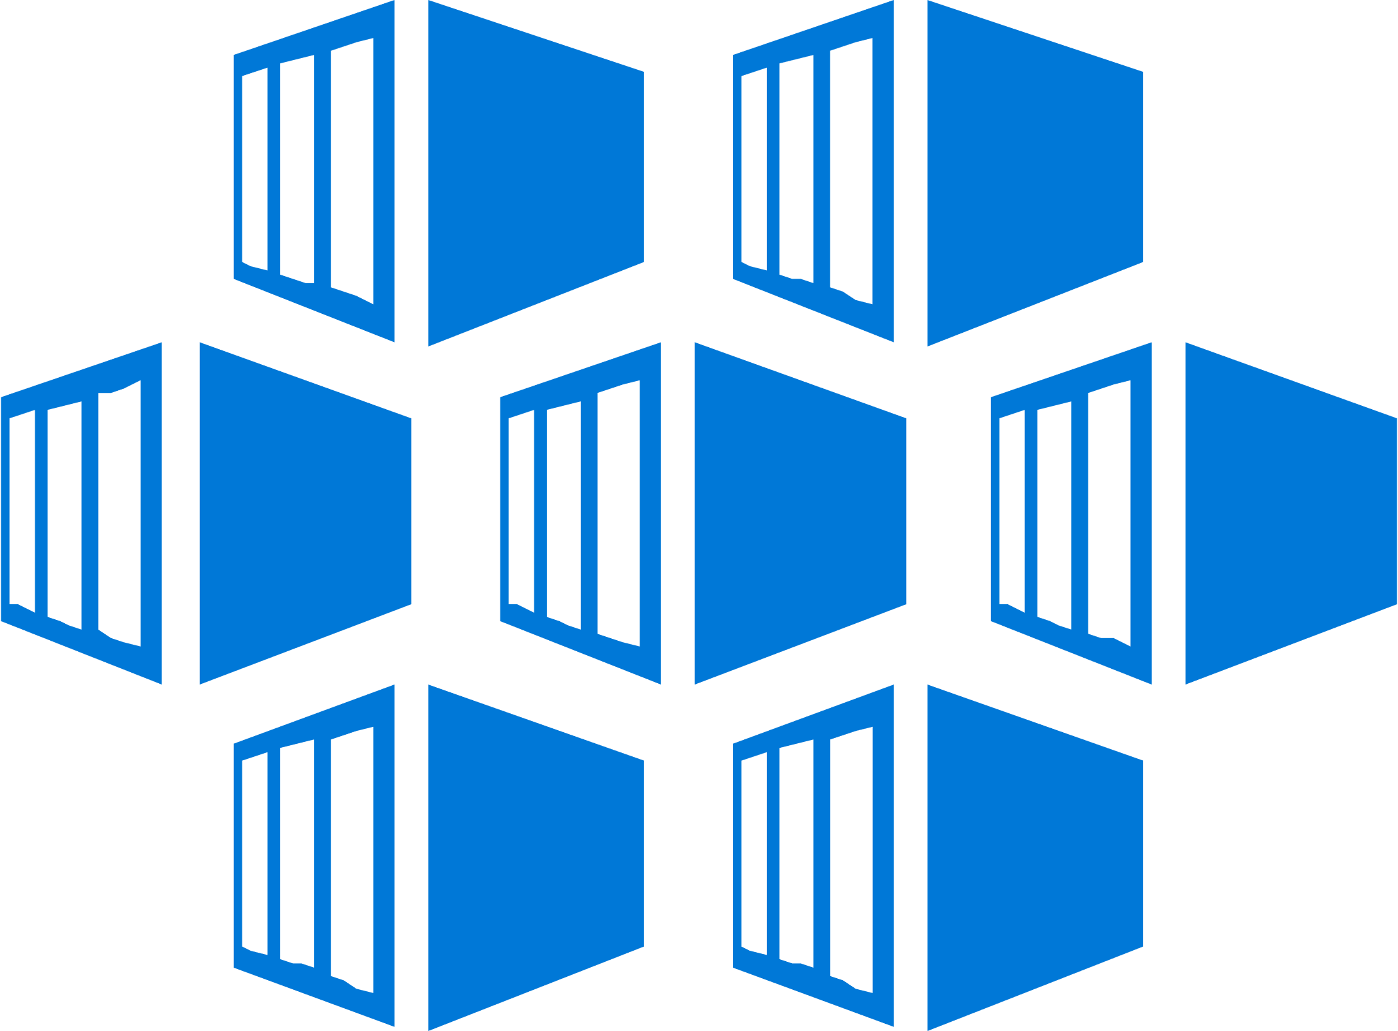
App Modernization – Azure Hosting and Orchestration

Slide 2
Containers on Azure
Flexibility
Productivity
Trust
Deploy containerized applications in your preferred environment
Accelerate containerized application development
Manage, monitor, and help secure your containers

Slide 3

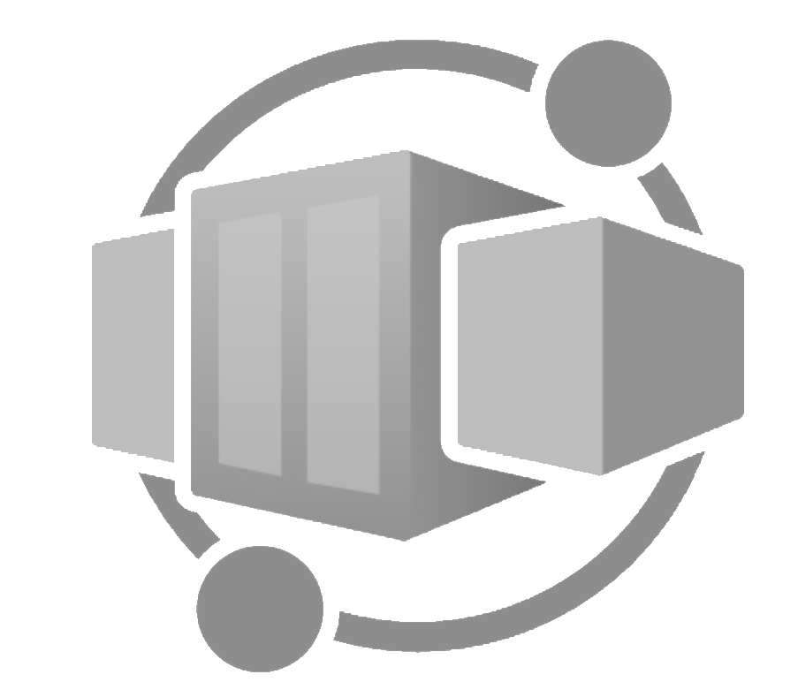
Flexibility Choose the platform that meet your container needs
Flexibility
Productivity
Trust
Deploy web apps or APIs using Linux containers in a PaaS environment
Azure App Service
Scale and orchestrate Linux or Windows containers using Kubernetes
Azure Kubernetes Service (AKS)
Enjoy the benefits of running containers while leaving behind the concerns of managing cloud infrastructure and complex container orchestrators.
Azure Container Apps (public preview)

Slide 4
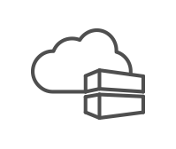
Productivity Accelerate containerized application development
Flexibility
Productivity
Trust
Automatically containerize and scaffold any applications directly from IDE
Auto-build to a secure container registry
Rapidly iterate, test and debug microservices
A few clicks to receive a full CI/CD pipeline
Built-in monitoring and logging to get full visibility of container health and app telemetry

Slide 5



Productivity Choose from 100+ services from Marketplace
Flexibility
Productivity
Trust
Database
IoT
Security
Container platform of your choice
Storage
Intelligence
Analytics
Azure
Cache
Integration
OSS services

Slide 6
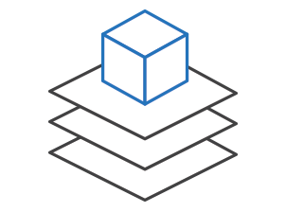

Trust Manage, monitor, and secure your containers
Flexibility
Productivity
Trust
Efficiently manage container images
Manage a Docker private registry as a first-class Azure resource with Container Registry. Manage container images with familiar, open-source Docker command-line interface (CLI) tools.
Gain visibility into your containers
Get a full view of your container deployment. View centralized CPU, memory, storage, and network and performance information with tools like Application Insights and Log Analytics.
Integrate security with container applications
Provide full-stack security for your containers including vulnerability scanning, run-time protection, and compliance. Add single sign-on with Azure Active Directory.

Slide 7
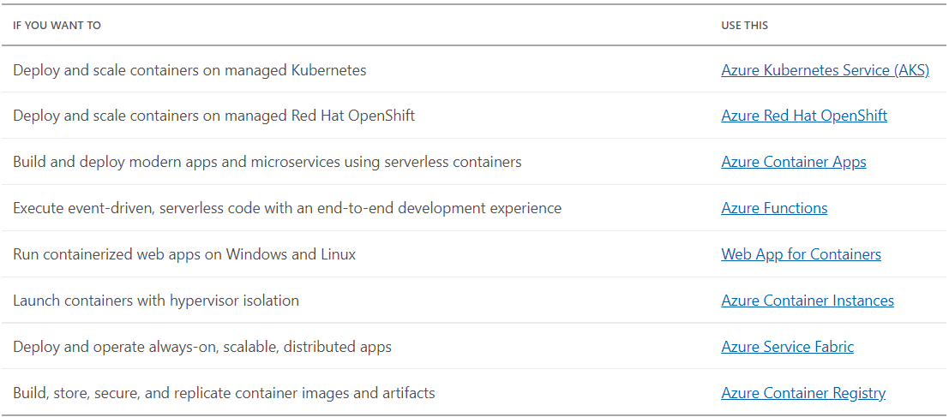
Microsoft Offerings for Containers
Notes:
Azure Containers—Services and Management | Microsoft Azure

Slide 8



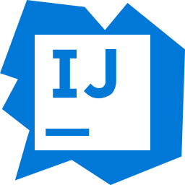

App Service
App Service
Easily deploy and run container-based web apps at scale
Azure Container Instances (ACI)
Accelerated outer loop
Fully managed platform
Flexibility & choices
Azure Container Registry (ACR)
Tight integration w/ Docker Hub, Azure Container Registry
Automatic scaling and load balancing
From CLI, portal, or ARM template
Service Fabric
Built-in CI/CD w/ Deployment Slots
High availability w/ auto-patching
Single Docker image, multi container w/ Docker Compose
Azure Container Apps (Preview)
Azure Kubernetes Service (AKS)
Intelligent diagnostics & troubleshooting, remote debugging
Backup & recovery
IntelliJ, , Jenkin, Maven Visual Studio family

Slide 9
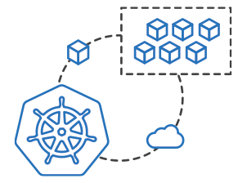
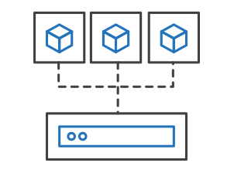
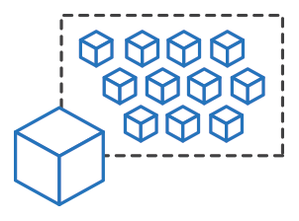
Azure Container Instances (ACI)
App Service
Easily run containers on Azure without managing servers
Azure Container Instances (ACI)
Azure Container Registry (ACR)
Service Fabric
Run containers without managing servers
Increase agility with containers on demand
Secure applications with hypervisor isolation
Azure Container Apps (Preview)
Azure Kubernetes Service (AKS)

Slide 10
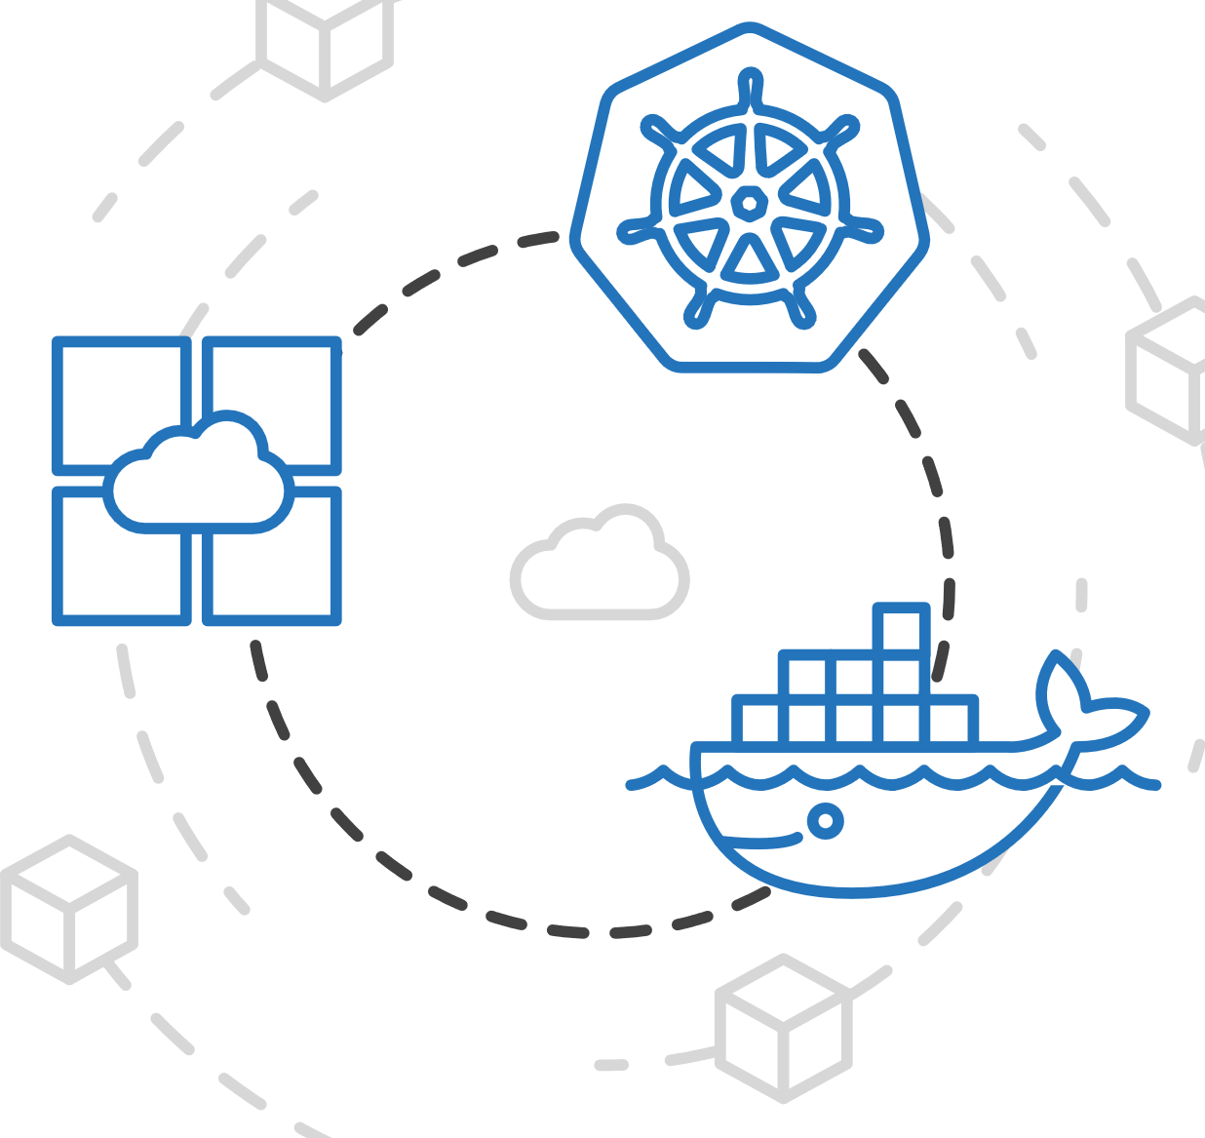
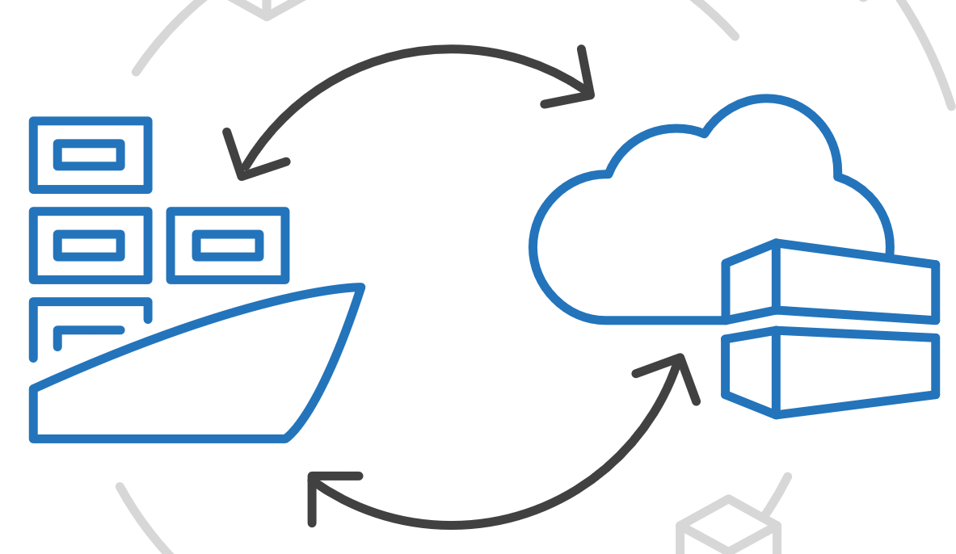
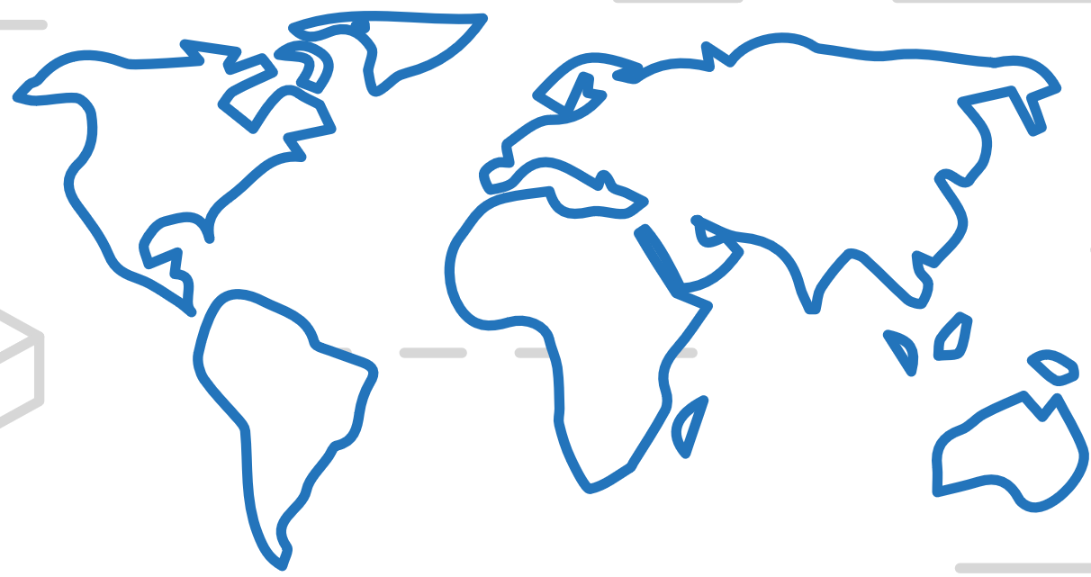
Azure Container Registry (ACR)
App Service
Manage a Docker private registry as a first-class Azure resource
Azure Container Instances (ACI)
Azure Container Registry (ACR)
Service Fabric
Manage images for all types of containers
Use familiar, open-source Docker CLI tools
Azure Container Registry geo-replication
Azure Container Apps (Preview)
Azure Kubernetes Service (AKS)

Slide 11


Azure Service Fabric
App Service
A microservices platform for business critical applications
Azure Container Instances (ACI)
Build
Deploy
Operate
Azure Container Registry (ACR)
always-on, highly scalable microservice apps
Service Fabric
</>
.NET
</>
Azure Container Apps (Preview)
Flexible infrastructure
Lifecycle management
24/7 availability & performance
Elastic scalability
Microservice and container orchestration
Security & compliance
Health & monitoring
Azure Kubernetes Service (AKS)

Slide 12
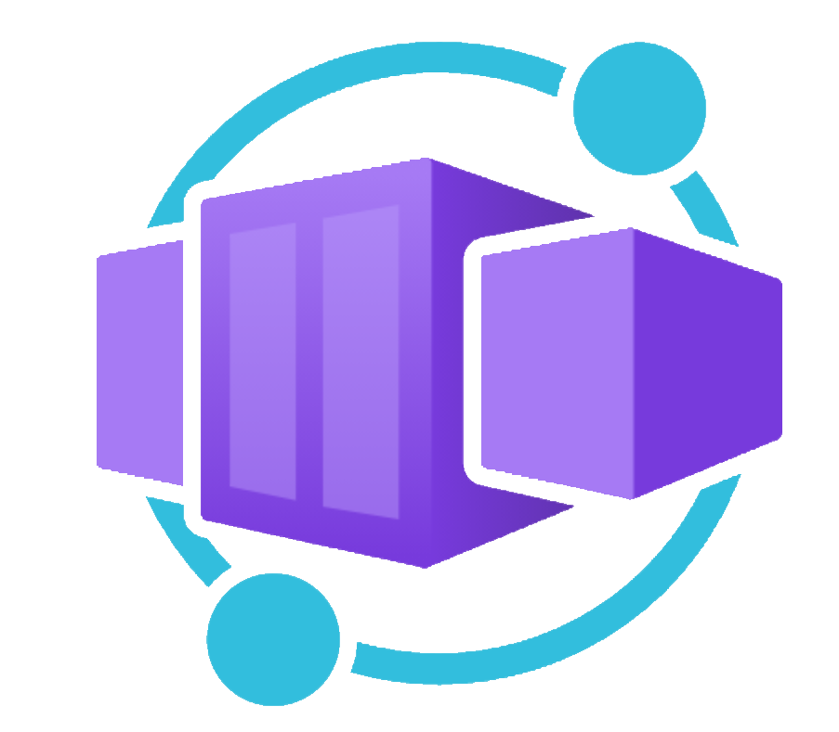
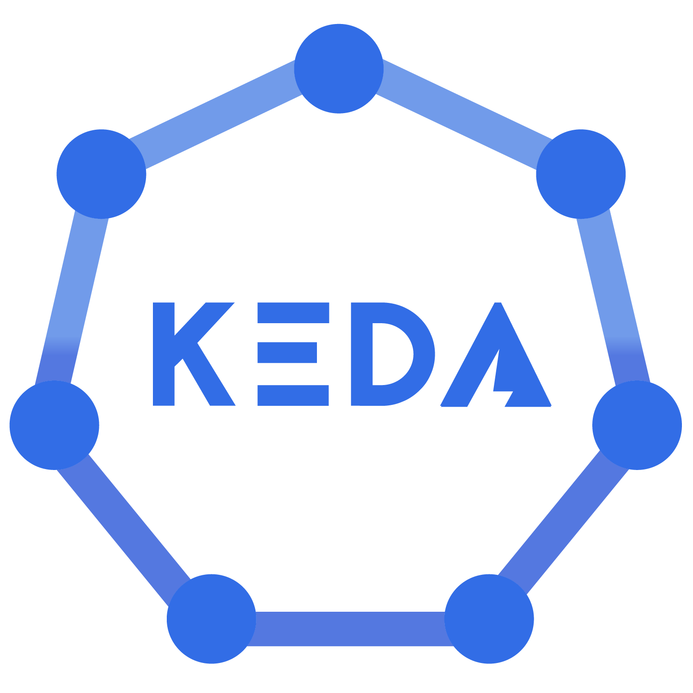

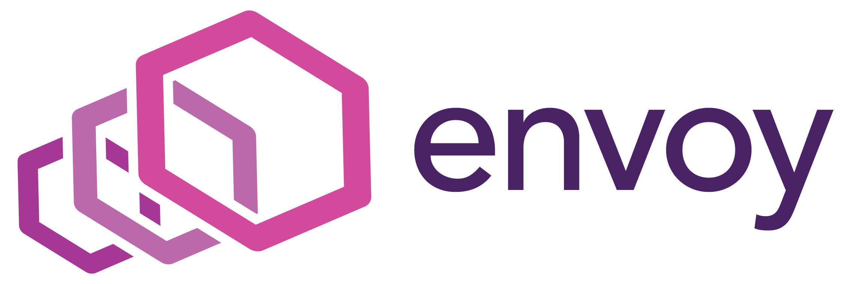
Azure Container Apps (Preview)
App Service
A new serverless container platform for building modern apps and microservices
Azure Container Instances (ACI)
Azure Container Registry (ACR)
Service Fabric
Enjoy the benefits of running containers while leaving behind the concerns of managing cloud infrastructure and complex container orchestrators.
Serverless (scale to zero support)
Scale on HTTP requests, events, or run always-on background jobs
Automatic encryption for ingress and service-to-service communications
Built on a foundation of AKS, KEDA, Dapr, and Envoy
Azure Container Apps (Preview)
Azure Kubernetes Service (AKS)
Notes:
NOTE: web app for container + docker compose will never go out of preview

Slide 13
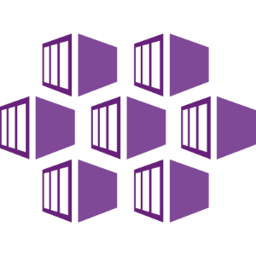

Azure Kubernetes Service (AKS)
App Service
Microsoft Hosted Kubernetes Service
Azure Container Instances (ACI)
Azure Container Registry (ACR)
!=
Service Fabric
Azure Container Apps (Preview)
What is Kubernetes?
Azure Kubernetes Service (AKS)
Notes:
Mention that Azure K

Slide 14
Kubernetes
App Service
The de-facto orchestrator
Azure Container Instances (ACI)
Azure Container Registry (ACR)
Service Fabric
Portable
Public
Private
Hybrid
multi-cloud
Extensible
Modular
pluggable
Hookable
composable
Self-healing
Auto-placement
auto-restart
auto-replication
auto-scaling
Azure Container Apps (Preview)
Azure Kubernetes Service (AKS)
Notes:
Mention that Azure K

Slide 15
Kubernetes
App Service
Empowering you to do more
Azure Container Instances (ACI)
Azure Container Registry (ACR)
Service Fabric
Deploy your applications quickly and predictably
Scale your applications on the fly
Roll out new features seamlessly
Limit hardware usage to required resources only
Azure Container Apps (Preview)
Azure Kubernetes Service (AKS)
Notes:
Mention that Azure K

Slide 16

What Kubernetes is not?
App Service
Azure Container Instances (ACI)
Kubernetes is not a traditional all-inclusive PaaS
Default solutions are optional and pluggable
Kubernetes does not:
limit the types of applications supported
deploy source code and does not build your application
provide application-level services, such as middleware, data-processing frameworks, databases, caches, nor cluster storage systems as built-in services
dictate logging, monitoring, or alerting solutions
nor mandate a configuration language/system
Azure Container Registry (ACR)
Service Fabric
Azure Container Apps (Preview)
Azure Kubernetes Service (AKS)
Notes:
Mention that Azure K

Slide 17
Azure Kubernetes Service (AKS)
App Service
Simplify the deployment, management, and operations of Kubernetes
Azure Container Instances (ACI)
Azure Container Registry (ACR)
Deploy and manage Kubernetes with ease
Scale and run applications with confidence
Secure your Kubernetes environment
Service Fabric
Azure Container Apps (Preview)
Accelerate containerized application development
Work how you want with open-source tools & APIs
Set up CI/CD in a few clicks
Azure Kubernetes Service (AKS)

Slide 18
Manage Kubernetes with ease
Responsibilities | DIY with Kubernetes | Managed Kubernetes on Azure
Containerization
Application iteration, debugging
CI/CD
Provisioning, upgrades, patches
Reliability availability
Scaling
Monitoring and logging
Azure managed control plane
App/ workload definition
Self-managed master node(s)
Kubernetes API endpoint
etcd Store
User
API server
Scheduler
Controller Manager
Cloud Controller
Schedule pods over private tunnel
Customer VMs
containerd
containerd
containerd
containerd
containerd
Pods
Pods
Pods
Pods
Pods
Customer
Microsoft
Notes:
A Kubernetes cluster is typically made up of
Master nodes for system components like the API server, etcd store, and scheduler
Agent nodes for user container workloads
Managing the cluster involves:
Monitoring the API server
Ensuring HA/DR for the etcd store
Safely managing upgrades across Kubernetes versions
Safely scaling the cluster in and out
Patching master and agent VM nodes
And on and on…
This is complex, error-prone, and expensive
A managed service like AKS moves those tasks to the cloud provider

Slide 19
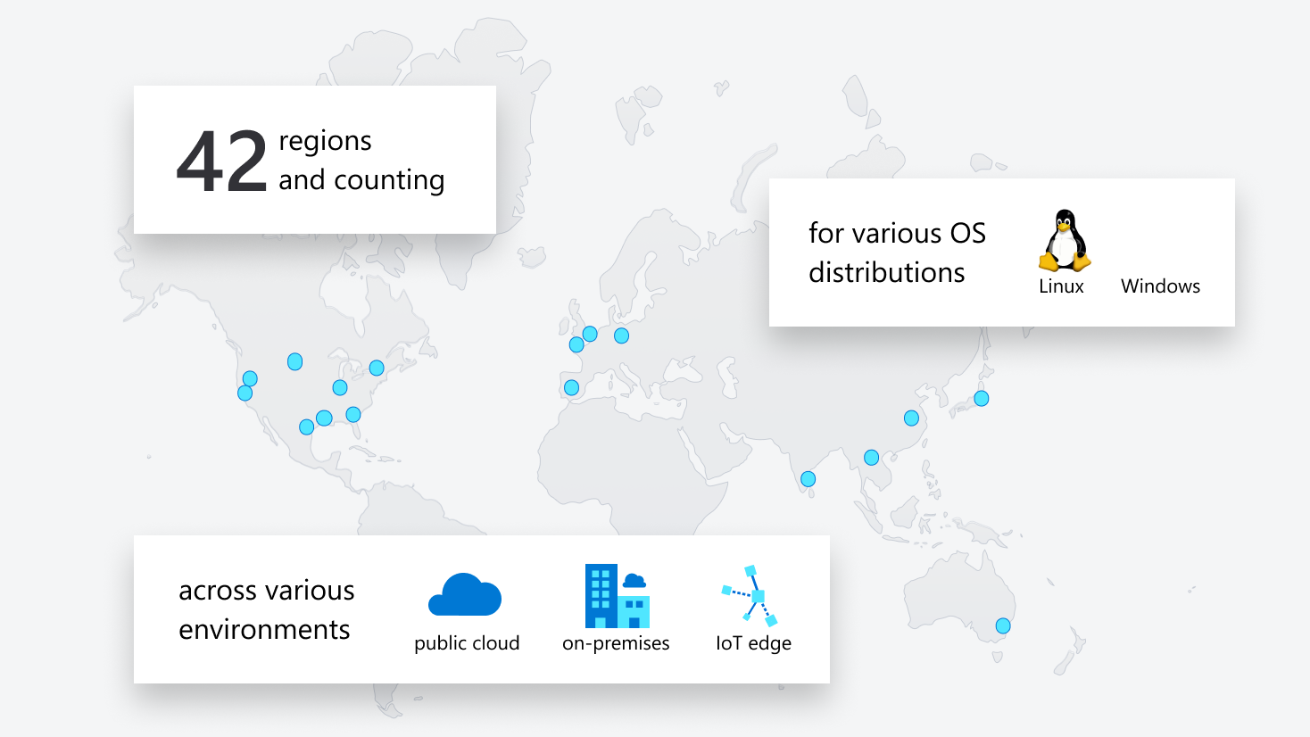
Run anything, anywhere
Notes:
Orchestrate any type of workload running in the environment of your choice. Whether you want to move .NET applications to Windows Server containers, modernize Java applications in Linux containers, or run microservices applications in the public cloud, at the edge, or in hybrid environments, Azure has the solution for you.

Slide 20














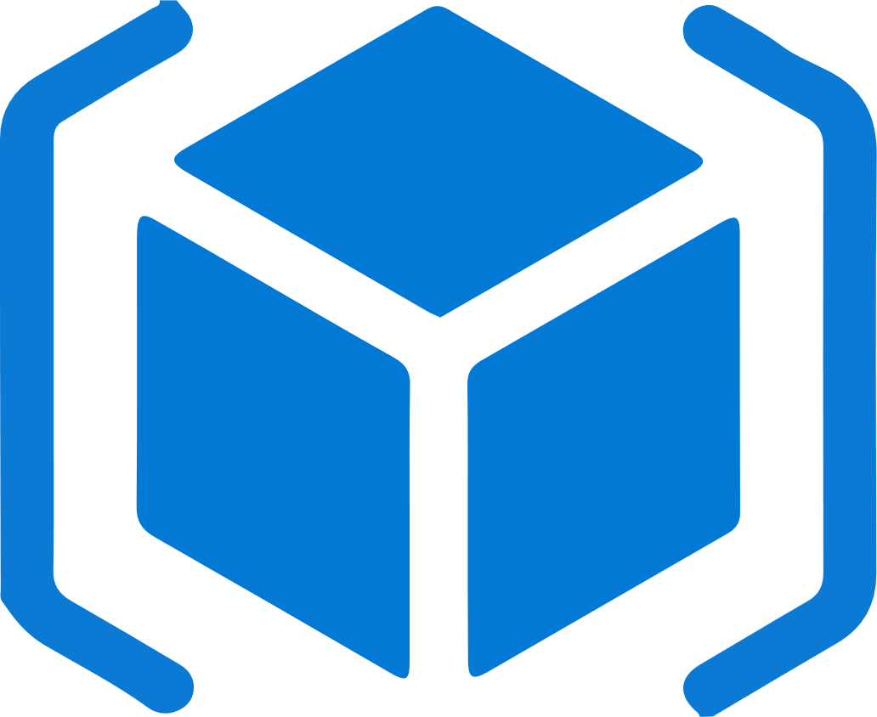
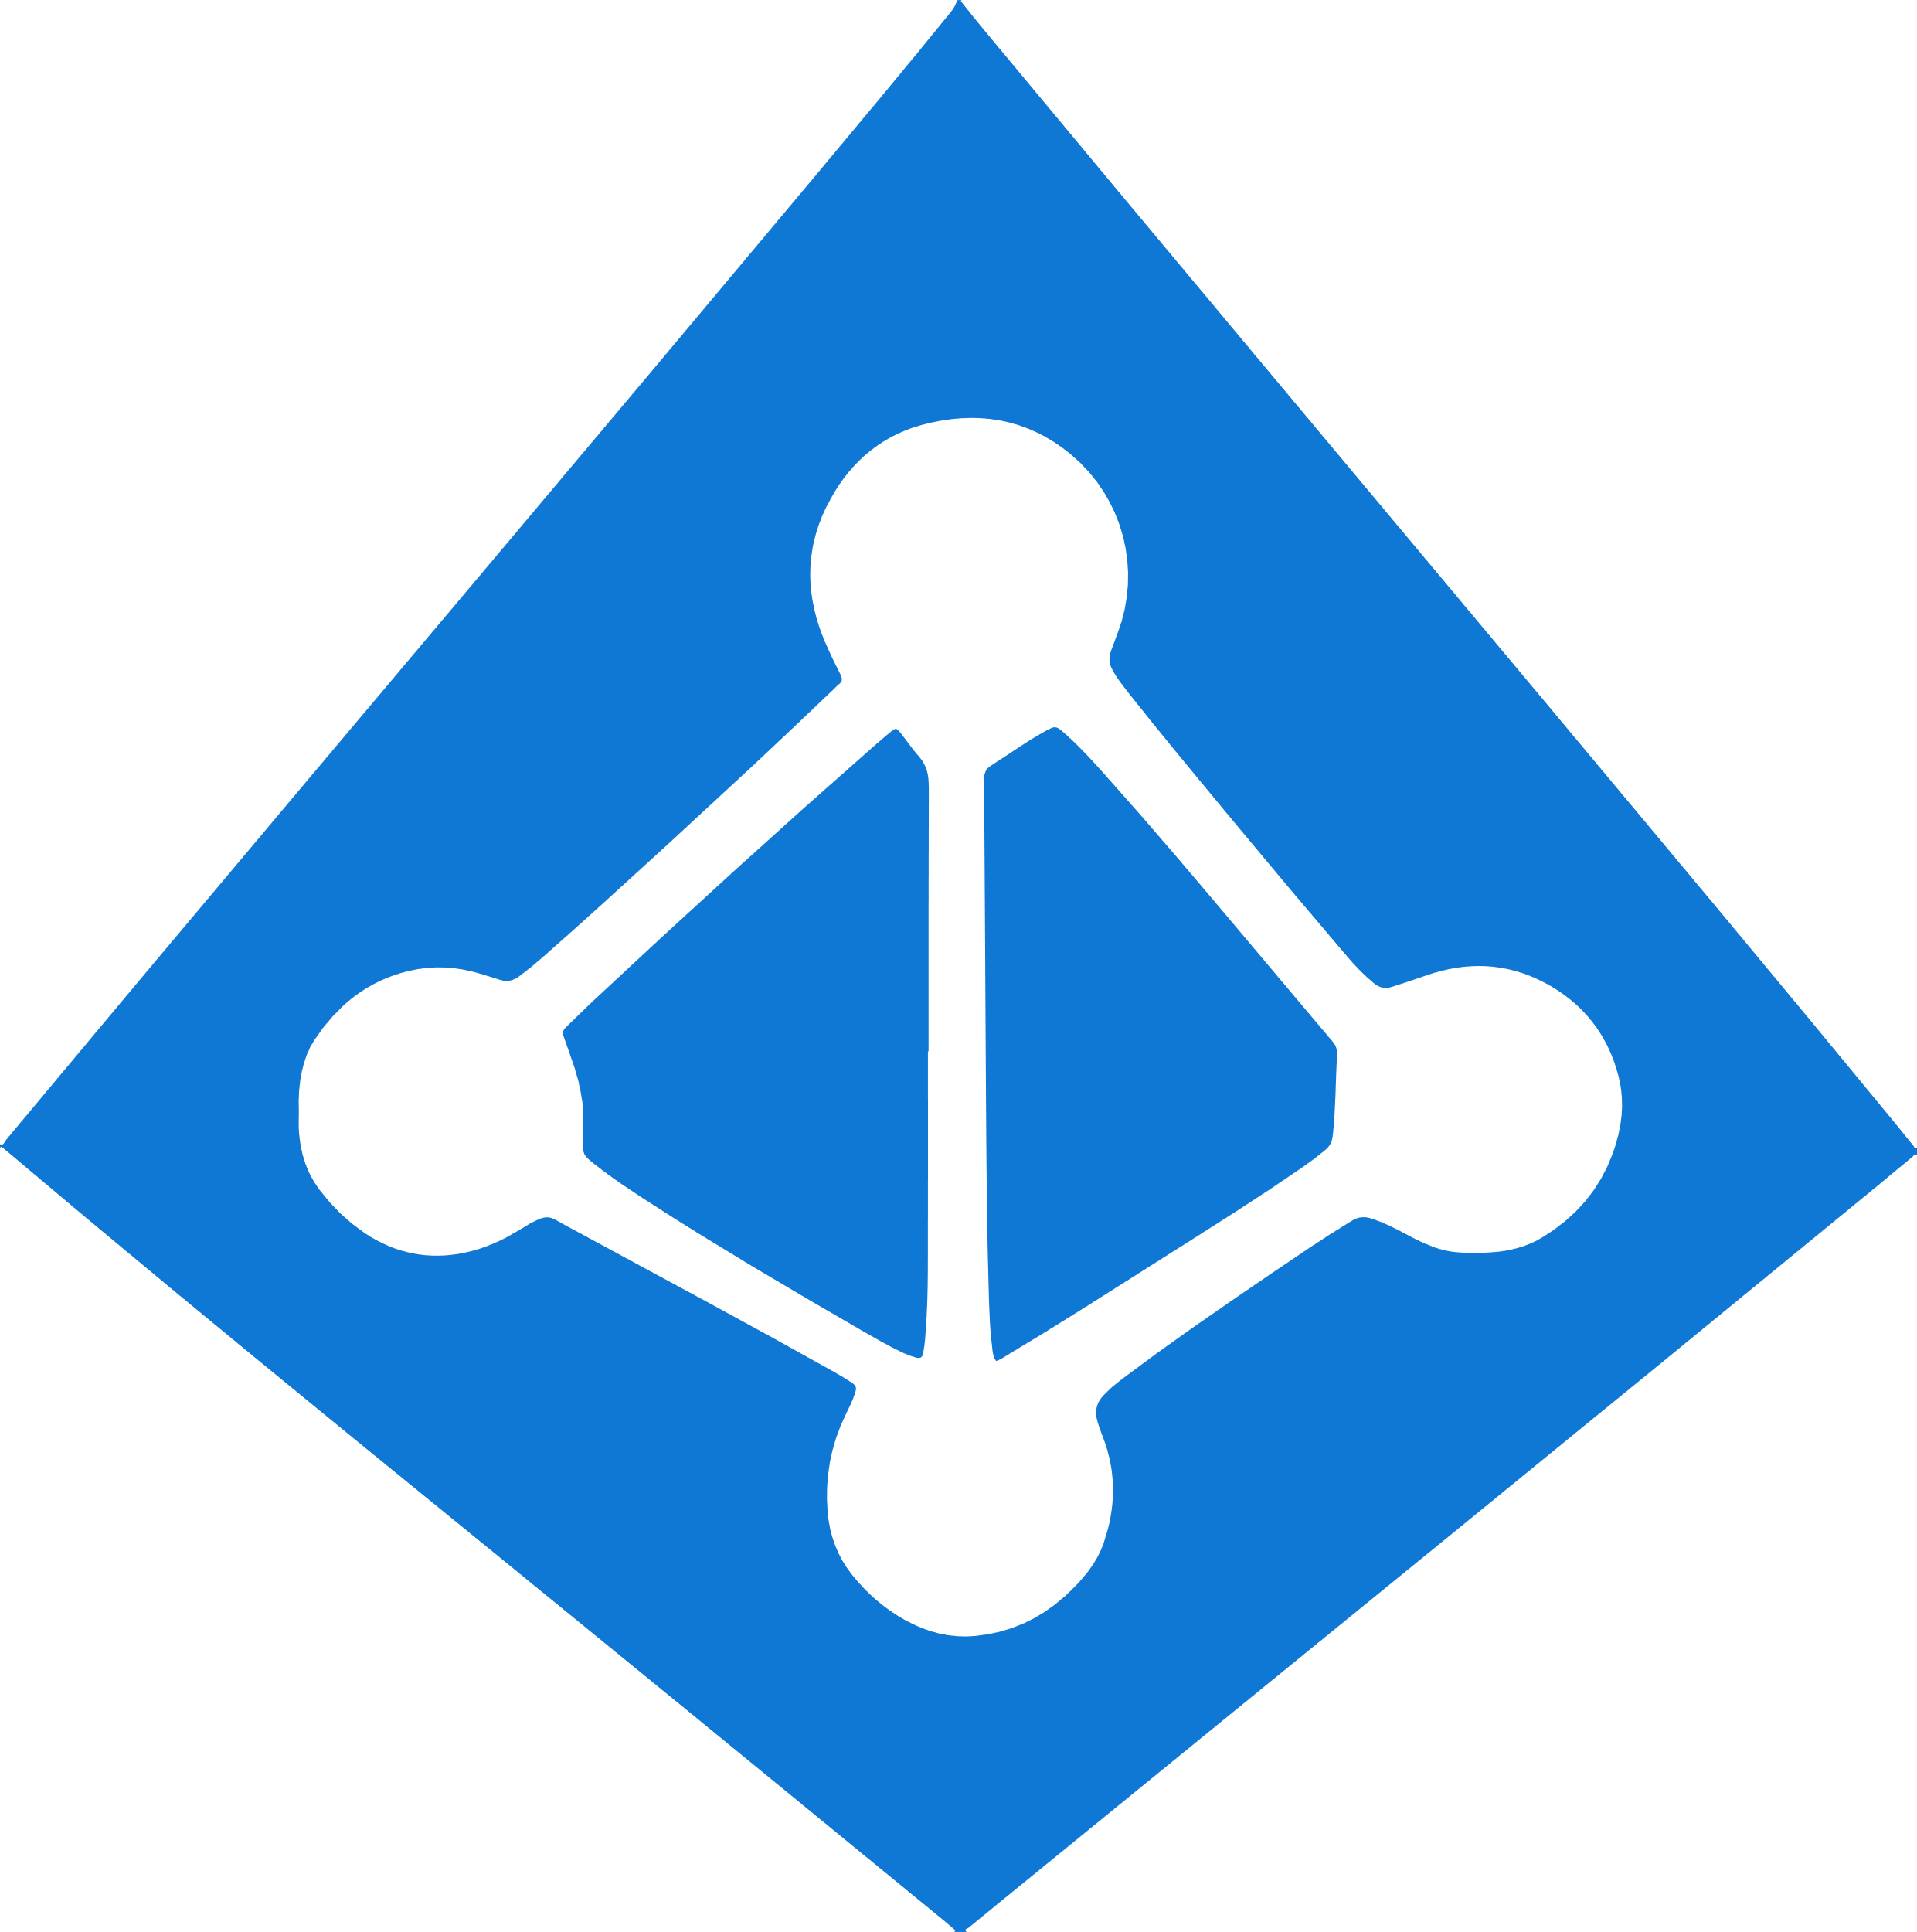




Work how you want with opensource tools and APIs
 | Development | DevOps | Monitoring | Networking | Storage | Security
Take advantage of services and tools in the Kubernetes ecosystem
Leverage 100+ turn-key Azure services
Virtual kubelet
CNAB
Visual Studio Code
Azure Pipelines
Azure VNET
Azure Policy
Azure Monitor
Service Mesh Interface
Azure Storage
GitHub
ARM
AAD
ASC
Container Registry
Azure Cosmos DB
Key Vault

Slide 21

Azure Kubernetes Service (AKS)
App Service
Additional benefits
Azure Container Instances (ACI)
Free! You only pay for worker nodes in cluster, not for the masters
Management of your service through Azure portal
CNCF-certified as Kubernetes conformant.
AKS is compliant with SOC, ISO, PCI DSS, and HIPAA
Azure Container Registry (ACR)
Service Fabric
Azure Container Apps (Preview)
Azure Kubernetes Service (AKS)

Slide 22
Thank you

